Slide 1
Chapter 8
Structures& Large Program Desing

Slide 2

Introduction
Structure is a method for grouping a several related data type together.
Variables with different types can be grouped in a structure
Structure is a advanced data type in C.
Structure
The simple variables : int a , b;
a=20, b=85; - invidual
Array ：float grade[20];
same type related
grade[0]
grade[1]
grade[2]
grade[3]
……

Slide 3


int
char
float
char
How can we define related data that have different type ?
num
name
grade1
grade2
10
Li
90.5
A
11
Liu
80
B
struct
{ int num;
char name[10];
float grade1;
char grade2; };
12
Wen
88
B
….

Slide 4


wang | 98 | 88 | 98 | 87
li | 87 | 66 | 83 | 67
zhan | 78 | 87 | 75 | 61
liu | 90 | 76 | 81 | 72
zhao | 87 | 81 | 74 | 71
All variables with the same types can be grouped in a array.
structure members ( type ,name)
All variables with different types can be grouped in a structure
Structure variables
name | age | sex | add
wang | 18 | m | 3-110
li | 20 | f | 7-121
liu | 17 | f | 7-212
zhao | 18 | m | 3-222
Content

Slide 5
Defining structure,then declaring struct variables.
Defining structure
struct name
{ type1 member 1;
type2 member 2;
︰
typen member n; };
struct student
{ int num;
char name[10];
float grade1;
char grade2; };
Structure is only as structure template, not occupying memory, because no any variable yet.
num | name | grade1 | grade2

Slide 6

struct struct_name struct_variable_name;
struct data
{
char name[20];
int age;
char address[30];
long telephone;
}
struct data wang;
struct data li,zhang;
name | age | address | telephone

Slide 7

struct data{
char name[20];
int age;
char address[30];
long telephone;
};
struct data wang;
After declaration, computer will assign memory units to them.
name[20]
20 bytes
name[20]
age
2 bytes
age
address
30 bytes
address[30]
telephone
telephone
4 bytes

Slide 8
Defining structure and struct variables.
struct name {
type1 member 1;
type2 member 2;
︰
typen membern;
} variable 1, variable2…..;
struct student
{ int num;
char name[20];
char sex;
int age;
float score;
char addr[30];
}stu1,stu2;
num | name | sex | age | score | add
stu1
stu2

Slide 9
structure ’s name can be omitted
struct {
type1 member 1;
type2 member 2;
︰
typen membern;
} variable 1, variable2…..;
struct
{ int num;
char name[20];
char sex;
int age;
float score;
char addr[30];
} stu1,stu2;
num | name | sex | age | score | addr
201 | wang | M | 20 | 95 | Zhongguancun road
202 | li | F | 19 | 80 | Guangda Garden

Slide 10
struct student
{ int num;
char name[20];
char sex;
int age;
char addr[30];
} stu1= {112,“Wang Lin” , ‘M’, 19, “200 Beijing Road” };
struct
{ int num;
char name[20];
char sex;
int age;
char addr[30];
} stu1= { 112,“Wang Lin”,‘M’,19, “200 Beijing Road” };
How to use these values?

Slide 11
struct_ var_name . member_name
struct
{ int num;
char name[10];
float grade1;
char grade2 ;
} stud1,stud2,stud3;
where “ . ” is called
member operator.
stud1 . grade1=95;
stud1 . grade2=‘A’;
scanf ( “ %s , %f , %c, ”, &stud2.name, &stud2.grade1, &stud2.grade2);
printf ( “ %s , %f , %c , ”, stude2.name, stude2 grade1, stude2 grade2);

Slide 12
10.4 Accessing Members of Structures
main( )
{ struct {
char initial; /* last name initial */
int age; /* childs age */
int grade; /* childs grade in school */
} boy , girl;
boy.initial = 'R';
boy.age = 17;
boy.grade = 75;
girl.age = boy.age - 1; /* she is one year younger */
girl.grade = 82;
girl.initial = 'H';
printf("%c is %d years old and got a grade of %d\n",
girl.initial, girl.age, girl.grade);
printf("%c is %d years old and got a grade of %d\n",
boy.initial, boy.age, boy.grade);
}
/* assignment */

Slide 13
One structure may be nested within another.
name | work address |  |  | Home address
 | post | addr | tel | post | addr | tel
struct address
{ int post;
char addr[100];
char tel[20]; };
struct personal
{ char name[20];
struct address workaddr ;
struct address homeaddr ; };
struct_var_name. out_mem . inner_mem

Slide 14
If the birthday is “11 / 11 /82”，which is the correct assignment statement?
Exercise:
struct student
{ int no;
char name[20];
char sex;
struct
{ int year;
int month;
int day;
}birth; };
struct student s;
A)year=1982
month=11
day=11
B)birth.year=1982,
birth.month=11
birth.day=11
C)s.year=1982
s.month=11
s.day=11
D) s.birth.year=1982
s.birth.month=11
s.birth.day=11

Slide 15
After declaration ,how to output ‘M’ ?
struct person{ char name[9];
int age;
};
struct person class[10]={ “W a n g” , 17,
“Z h a n g” ,19,
“M i n g” , 18,
“L i u” , 20 };
Member of array
Member of
structure array
A) printf(“%c\n”,class[ 3 ].name );
B) printf(“%c\n”,class[ 3 ].name[ 1] );
C) printf(“%c\n”,class[ 2 ].name[ 1] );
D) printf(“%c\n”,class[ 2 ].name[ 0] );

Slide 16
#include <stdio.h>
#include <string.h>
struct Consumption
{
char city[20];
int year ;
double usage;
};
struct Resource
{
char material[30];
double longitude;
double latitude;
double quantity;
char units[20];
};
void main (void )
{
struct Resource metal, fuel;
struct Resource wood = {"Oak", 32.5, 13.2, 5e+8, "hectares"};
struct Consumption water, power;

Slide 17
metal.longitude = 57.3;
metal.latitude = 32.1;
metal.quantity = 3e+10;
strcpy (metal.material, "Iron");
strcpy (metal.units, "cubic meters");
printf ("The metal information is:\n%s\n%4.1lf degrees longitude\n"
"%4.1lf degrees latitude\n%e %s\n\n",
metal.material, metal.longitude, metal.latitude,
metal.quantity, metal.units);
printf ("Enter water and power:\ncity, year and usage\n");
scanf ("%s%d%lf%s%d%lf", water.city, &water.year, &water.usage,
power.city, &power.year, &power.usage);
printf ("\n\nThe water and power are:\n%s\n%d\n%5.0lf million liters\n\n"
"%s\n%d\n%5.0lf mega watts\n",
water.city, water.year, water.usage,
power.city, power.year, power.usage);
}

Slide 18
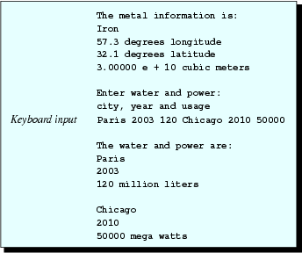
Output

Slide 19
struct Yyy {
char dd[50];
struct Xxx mm;
char *ee;
char *ff[3];
};
struct Xxx {
char aa[30];
int bb[2];
double cc;
};
void main (void) {
struct Xxx qq = {{"Sample"},{0,1},{5.4}};
struct Yyy nn = {{"String constant"},{{"Text"},{7,8},{12.3}},{"Address"},{"a","b","c"}};
struct Yyy pp, rr;
strcpy (pp.dd,"Structure ");
strcpy (pp.mm.aa,"in structure");
pp.mm.bb[0] = 10;
pp.mm.bb[1] = 12;
pp.mm.cc = 57.8;
pp.ee = "Pointer and ";
pp.ff[0] = "array ";
pp.ff[1] = "of ";
pp.ff[2] = "pointers. ";
rr=pp;
printf ("%s%s %d %d %lf\n%s%s%s%s\n",rr.dd,rr.mm.aa,rr.mm.bb[0],
rr.mm.bb[1],rr.mm.cc,rr.ee,rr.ff[0],rr.ff[1],rr.ff[2]);
}

Slide 20


Nested Structure
Output
Structure member can be another structure
Access using two dot operators

Slide 21
Pointers to Structures
struct Xxx
{
int aa;
double bb;
};
void main (void)
{
struct Xxx mm;
struct Xxx *pp;
mm.aa = 8;
mm.bb = 23.2;
pp = &mm;
(*pp).aa = 12 ;
pp->bb = 97.2;
printf ("%d %lf\n", mm.aa, mm.bb);
}

Slide 22

Pointers to Structures
Output
To declare pointer to structure
struct Xxx *pp;
same as other pointer declaration
Pointer assignment
pp = &mm;
assigns the address of the beginning of the mm to pp

Slide 23
Access Members Using Pointers
2 methods
pp = &mm;
(*pp).aa = 12 ;
parentheses necessary because dot operator has higher precedence than *
structure pointer operator (->)
general form
pointer_to_structure -> member_name
pp = &mm;
pp->bb = 97.2;

Slide 24
#include "stdio.h"
struct ks
{
int a;
int *b;
}s[4],*p;
void main( )
{
int n=1,i;
printf("\n");
for(i=0;i<4;i++)
{
s[i].a=n;
s[i].b=&s[i].a;
n=n+1;
}
p=&s[0];
p++;
printf("%d,%d\n",(++p)->a,(p++)->a);
}

Slide 25
Structures and Functions
struct Xxx
{
int aa;
double bb[2];
char *cc;
char *dd[3];
};
void function1 (struct Xxx *qq, struct Xxx *rr);
void main (void)
{
struct Xxx mm, nn;
function1 (&mm, &nn);
printf ("%d %lf %lf %s%s%s%s\n", mm.aa, mm.bb[0], mm.bb[1],
mm.cc, mm.dd[0], mm.dd[1], mm.dd[2]);
printf ("%d %lf %lf %s%s%s%s\n", nn.aa, nn.bb[0], nn.bb[1],
nn.cc, nn.dd[0], nn.dd[1], nn.dd[2]);
}

Slide 26
Structures and Functions (con’t)
void function1 (struct Xxx *qq, struct Xxx *rr )
{
(*qq).aa = 12;
(*qq).bb[0] = 23.4;
(*qq).bb[1] = 34.5;
(*qq).cc = "Structure ";
(*qq).dd[0] = "passed ";
(*qq).dd[1] = "to ";
(*qq).dd[2] = "function.";
rr->aa = 15 ;
rr->bb[0] = 45.6;
rr->bb[1] = 67.8 ;
rr->cc = "Pointer ";
rr->dd[0] = "operators ";
rr->dd[1] = "can ";
rr->dd[2] = "be used.";
}

Slide 27

Structures and Functions
Output
To modify structure (members) when passing it to a function, structure’s address (address of its first member) is passed
function1 (&mm, &nn);
Within the function
(*qq).aa = 12;
rr->aa = 15 ;
where qq = &&mm and rr = &nn
-> is usually preferred

Slide 28
union
  Memory that contains a variety of objects over time
  Only contains one data member at a time
  Members of a union share space
  Conserves storage
  Only the last data member defined can be accessed
union declarations
  Same as struct
      union Number {
      int x;
      float y;
      };
      union Number value;

Slide 29
Valid union operations
  Assignment to union of same type: =
  Taking address: &
  Accessing union members: .
  Accessing members using pointers: ->

Slide 30
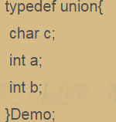
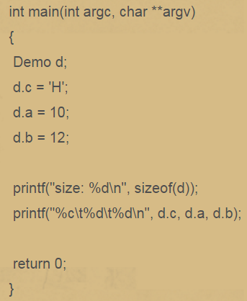


Slide 31
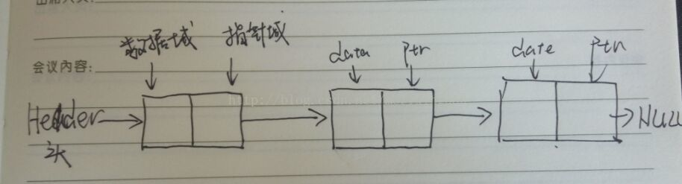
Linked list
解决数组无法存储多种数据类型的问题。
解决数组中，元素个数无法改变的限制。
数组移动元素的过程中，要对元素进行大范围的移动，很耗时间，效率也不高。

Slide 32
struct list_node
{
int data ; //数据域，用于存储数据
struct list_node *next ; //指针，可以用来访问节点数据，也可以遍历，指向下一个节点
};

Slide 33
struct list_node
{
int data ;
struct list_node *next ;
};
typedef struct list_node list_single ;
int main(void)
{
list_single *node = NULL ; //1、首先，当然是定义一个头指针
node = (list_single *)malloc(sizeof(list_single)); //2、然后分配内存空间
if(node == NULL){
printf("malloc fair!\n"); }
memset(node,0,sizeof(list_single)); //3、清一下
node->data = 100 ; //4、给链表节点的数据赋值
node->next = NULL ; //5、将链表的指针域指向空
printf("%d\n",node->data);
free(node);
return 0 ; }

Slide 34
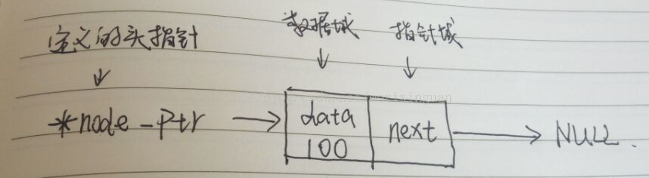

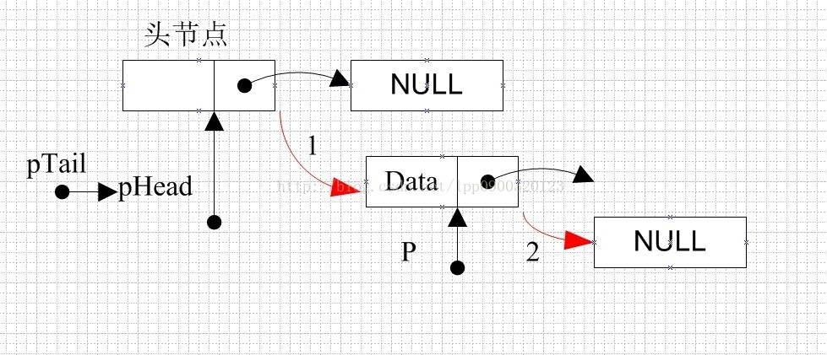

Slide 35
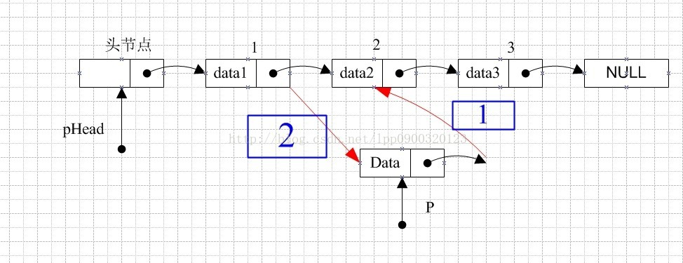
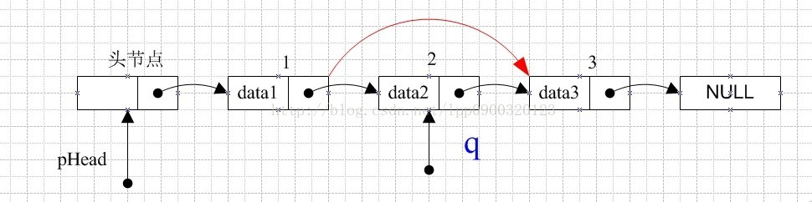

Slide 36
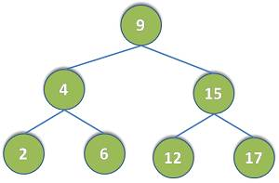
Binary tree

Slide 37
typedef struct BTNode{
int data;
struct BTNode *lChild;
struct BTNode *rChild;
}BiTNode;

Slide 38
//先序创建二叉树
int CreateBiTree(BiTNode **T)
{
int ch;
scanf("%d",&ch);
if (ch == -1)
{
*T = NULL;
return 0;
}
else
{
*T = (BiTNode *)malloc(sizeof(BiTNode));
if (T == NULL)
{
printf("failed\n");
return 0;
}
else
{
(*T)->data = ch;
printf("输入%d的左子节点：",ch);
CreateBiTree(&((*T)->lChild));
printf("输入%d的右子节点：",ch);
CreateBiTree((&(*T)->rChild));
}
}
return 1;
}

Slide 39
Recursions
Three phases of operations
Calling phase
  the function is called repeatedly
Reversal phase
  callings phase ends when the function encounters the simplest case
  performs one complete pass through the function
Return phase
  values returned allow the earlier function calls to complete their operations
  When the first function call has completed, the recursion is finished.

Slide 40
void main (void) {
int a=10, b=15, n=5, sum;
sum = function1 (a,b,n);
printf ("\n\n The end result is sum = %d \n", sum);
}
int function1 (int i, int j, int k) {
int tot;
k--;
if (k != 0) {
printf ("Values in phase 1 - calling phase\n"
" i = %d j = %d k = %d tot = %d \n“, i,j,k,tot);
tot = (i+j) + function1 (i,j,k) ;
printf ("Values in phase 2 - returning phase\n"
" i = %d j = %d k = %d tot = %d \n“, i,j,k,tot);
return (tot);
} else {
tot = i+j;
printf ("Values at reversal\n"
" i = %d j = %d k = %d tot = %d \n", i,j,k,tot);
return (tot);
}
}

Slide 41
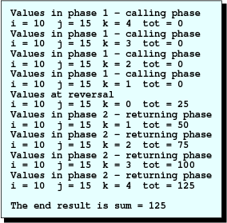
Function with 1 Recursive Call
Output

Slide 42
Header file
# include <stdio.h>
# include <math.h>
# include <stdlib.h>
# define MAX 10
void function1(int, double,int);
#include "header_1.h"
void main (void) {
int ii;
double xx;
ii = 3;
xx = 44.7;
function1 (ii,xx,MAX);
system("pause");
}
void function1 (int kk, double yy, int nn) {
double pp;
pp = kk+log(yy)+nn;
printf ("pp=%lf\n",pp);
}

Slide 43
Multiple Source Files
# include<stdio.h>
int add(int a,int b);
void main()
{
int a = 1,b =2;
int c = add(a,b);
printf("c=%d\n",c);
}
int add(int a,int b)
{
return a+b;
}

Slide 44
Thank you!
Q & A

